Slide 1
PROFESSIONAL ETHICS CE 3142 COMPUTER ETHICS
Faculty of Engineering,
General Sir John Kotelawala Defence University
19th April 2023

Slide 2
topics
Introduction
The internet and free speech
Social media
Computers, Internet and power relationships
Job elimination
Hackers
Ransomware
Data and Software
Embezzlement
ten Commandments of Computer Ethics
acknowledgement

Slide 3
INTRODUCTION
Computers have become the technological backbone of society. Their degree of complexity, range of applications, and sheer numbers continue to increase. Through telecommunication networks they span the globe. Yet electronic computers are still only a few decades old, and it is difficult to foresee all the moral issues that will eventually surround them.
It is already clear, however, that computers raise a host of difficult moral issues, many of them connected with basic moral concerns such as free speech, privacy, respect for property, informed consent and harm
To evaluate and deal with these issues, a new area of applied ethics called computer ethics has sprung up.
Computer ethics has special importance for the new groups of professionals emerging with computer technology, for example, designers of computers, programmers, systems analysts, and operators.

Slide 4
INTRODUCTION
To the extent that engineers design, manufacture, and use computers, computer ethics is a branch of engineering ethics.
But the many professionals who use and control computers share the responsibility for their applications.
the issues in computer ethics concern;
shifts in power relationships resulting from the new capacities of computers.
property,
invasions of privacy.
All these issues may involve “computer abuse”: unethical or illegal conduct in which computers play a central role, whether as instruments or objects

Slide 5
The Internet and Free Speech
The modest beginning of the internet came from a simple idea of J. C. R. Licklider, a psychologist who had wide interests in the newly emerging computer technology
In the 1980s, some universities developed their own communications networks, and their eventual merging became the Internet, which is now a global network, initially using the infrastructure of the telephone system and now carried by many telecommunication systems by wire, fiber, or wireless systems.
The World Wide Web (Www), which is a service run on the Internet, emerged from work done mainly in Europe, and was used in a multimedia format of text, pictures, sound, and video.
During the early 1990s, the Web was opened to business, e-mail, and other uses that continue to expand.
The Internet has magnified all issues in computer ethics. The most powerful communication technology ever developed, and a technology used daily by hundreds of millions of people, the Internet gained widespread use only during the 1990s

Slide 6
The Internet and Free Speech
the Internet provides a number of new ways to be in contact with other people and with sources of information.
It has also created greater convenience in ordering consumer items, paying bills, getting medical appointments, trading stocks and shares, etc.
However Like other major “social experiments,” it also has raised a host of new issues. One set of issues centers on free speech, including;
control of obscene forms of pornography,
hate speech,
spam (unwanted commercial messages),
libel.

Slide 7
The Internet and Free Speech
Social media
Social media are interactive computer-mediated technologies that facilitate the creation or sharing of information, ideas, career interests and other forms of expression via virtual communities and networks.
Some of the most popular social media websites, with over 100 million registered users, include Facebook (and its associated Facebook Messenger), YouTube, Instagram, QZone, Twitter, LinkedIn, WhatsApp, Snapchat, Pinterest, Viber, Reddit, and many more.

Slide 8
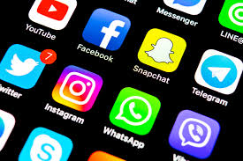
The Internet and Free Speech
Social media
it has brought a lot of advantages for society, with ethically utilizing the power of social media to enhance life and use it for the betterment of society.
However, on the other hand it has also affected the society in the negative way. Just like anything which can be used for both good and bad, social media have also provided the negative and positive ways for the people.
It is all about the usage and getting things
done correctly and positively by using the
power of social media.
It is in the hands of the user to ethically
use it to its advantage.

Slide 9
The Internet and Free Speech
Advantages of social media
Disadvantages of social media
Connectivity
Education
Help
Information & updates
Promotion
Noble causes
Awareness
Assist in fighting crime
Improve business reputation
Helps in building communities
Cyber-bullying
Hacking
Addiction
Fraud & scams
Security
Reputation
Cheating & relationship issues
Health issues
Cause of death
Glamourising drugs & Alcohol

Slide 10
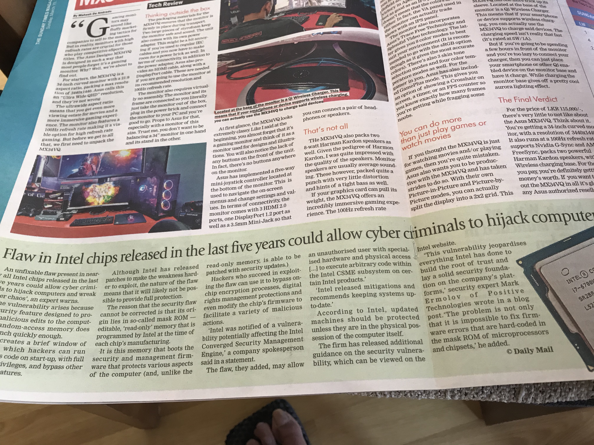
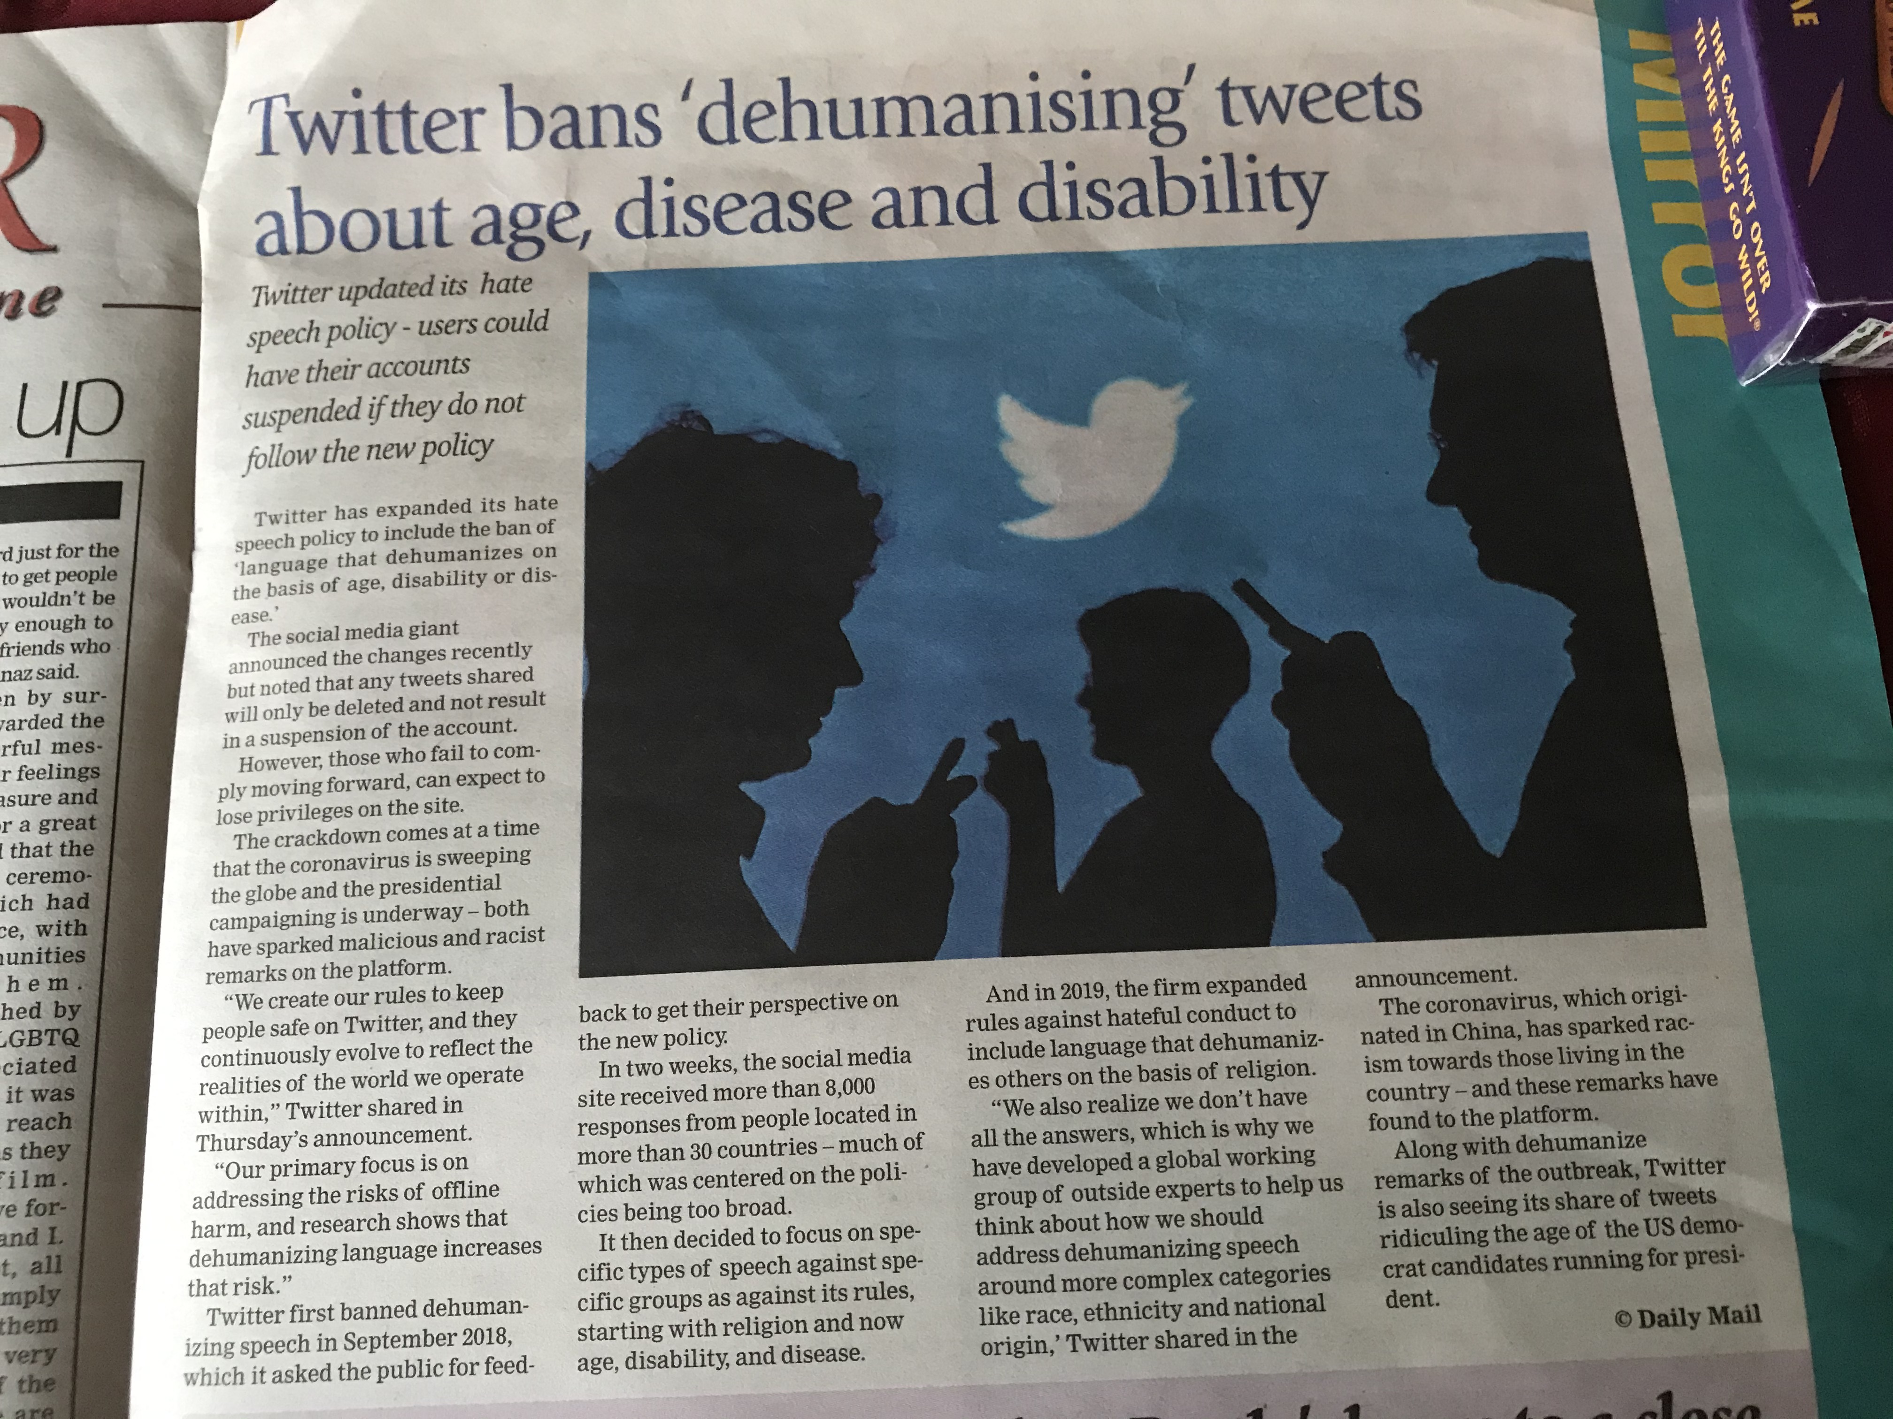
The Internet and Free Speech
An unfixable flaw present in nearly all Intel chips released in the last five years could allow cyber criminals to hijack computers and wreak “utter chaos”
Twitter expanded its “hate speech” policy to include the ban of “language that dehumanizes on the basis of age, disability and disease”
Sunday Times Magazine – 15 March 2020

Slide 11
Computers, Internet and power relationships
Computers and the Internet dramatically increase the ability of centralized bureaucracies to manage enormous quantities of data, involving multiple variables, and at astonishing speed
During the 1960s and 1970s people became alarmed at the prospect that computers would concentrate power in a few centralized bureaucracies of big government and big business, thereby eroding democratic systems by moving toward totalitarianism.
For example, Google keeps a record of every search you have done, when you did that search, and what links you clicked. So, the ethical dilemma becomes if it's morally justifiable or socially tolerable that one company can have such access to something you consider being a private activity.
Can the fact it may help identify and capture dangerous criminals make it acceptable?

Slide 12
Job elimination
people are generally fearful and distrustful of change. Change that involve new and complex technologies are especially stressful, particularly to older and less educated workers. They are fearful of losing their jobs, of losing control to machines, and of becoming useless.
Systems analysts, software engineers, and system designers need to be aware of these fears and need to directly address these fears in an honest and forthright manner, both to enhance the probability that the new system will contain the accumulated knowledge of these workers and will be used and to acknowledge their individual worth.
In addition, a major reason that management support the use of technology is to improve productivity, which in many instances mean the elimination (or radical redesign) of jobs.
In such a project, the designer of the new system can feel torn between their obligation to their employer to meet the specifications of the project and their obligations to fellow co-workers (and possibly friends) and to the needs of society.
Problems can arise from projects that either will result in reduced employment or will result in the need for workers with vastly different skill sets than that possessed by the present work force.

Slide 13
Job elimination
A new computer based technology is being considered by a company, which is better for the company as well as the clients. However if this is brought into use, a mainly computer literate work-force is required for the organization. Also lesser man-power will be needed.
The owner now has to decide whether he wants to treat his clients with good services or be loyal to his employees who have helped the company grow.
Here an ethical dilemma confronts the owner
In the above situation, what would be the best option?
Considering the well being of the staff, continue with the existing technology
Invest in the new technology and discontinue the redundant staff
Upgrade the process and (1) train staff in new technology, and (2) take steps to transfer the excess staff to other areas, ensuring continuity of service
Sell the company and get rid of the problem

Slide 14
Hackers
computer specialist who compulsively challenge any computer security system, either to flaunt their skills or for the more sinister and unethical purpose of extorting money.
Some carry their art to the point of implanting “time bombs” or “Trojan horses” (unwanted codes that copy themselves into larger programs) that will “choke networks with dead-end tasks, spew out false information, erase files, and even destroy equipment.
This form of vandalism can be extremely harmful and is a straight-forward violation of property rights, even if only by reducing productivity by shutting down computer systems.

Slide 15
Hackers
Heartland Payment Systems
Date: March 2008
Impact: 134 million credit cards exposed
Details: At the time of the breach, Heartland was processing 100 million payment card transactions per month for 175,000 merchants — mostly small- to mid-sized retailers. The breach was discovered in January 2009 when Visa and MasterCard notified Heartland of suspicious transactions from accounts it had processed. The attackers exploited a known vulnerability to perform a SQL injection attack. Security analysts had warned retailers about the vulnerability for several years, and it made SQL injection the most common form of attack against websites at the time.
Because of the breach, the Payment Card Industry (PCI) deemed Heartland out of compliance with its Data Security Standard (DSS) and did not allow it to process payments of major credit card providers until May 2009. The company also paid an estimated $145 million in compensation for fraudulent payments.
The Heartland breach was a rare example where authorities caught the attacker. A federal grand jury indicted Albert Gonzalez and two unnamed Russian accomplices in 2009. Gonzalez, a Cuban American, was alleged to have masterminded the international operation that stole the credit and debit cards. He was sentenced in March 2010 to 20 years in federal prison.

Slide 16
Hackers
Yahoo
Date: 2013-14
Impact: 3 billion user accounts
Details: Yahoo announced in September 2016 that in 2014 it had been the victim of what would be the biggest data breach in history. The attackers compromised the real names, email addresses, dates of birth and telephone numbers of 500 million users. Yahoo claimed that most of the compromised passwords were hashed.
Then in December 2016, Yahoo disclosed another breach from 2013 by a different attacker that compromised the names, dates of birth, email addresses and passwords, and security questions and answers of 1 billion user accounts. Yahoo revised that estimate in October 2017 to include all of its 3 billion user accounts.
The timing of the original breach announcement was bad, as Yahoo was in the process of being acquired by Verizon, which eventually paid $4.48 billion for Yahoo’s core internet business. The breaches knocked an estimated $350 million off the value of the company.

Slide 17
Hackers
As coronavirus threatens to become a global pandemic, everyone’s keeping a close eye on how it’s spreading across the world. Several organizations have made dashboards to keep track of COVID-19. But now, hackers have found a way to use these dashboards to inject malware into computers.
Attackers design websites related to coronavirus in order to prompt you to download an application to keep you updated on the situation. This application doesn’t need any installation, and shows you a map of how COVID-19 is spreading. However, it is a front for attackers to generate a malicious binary file and install it on your computer.

Slide 18
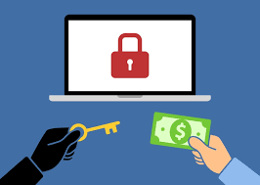
Hackers - ransomware
Ransomware is a type of malware that threatens to publish the victim's data or perpetually block access to it unless a ransom is paid.
While some simple ransomware may be reversed, more advanced malware use a technique in which it encrypts the victim's files, making them inaccessible, and demand a ransom payment to decrypt them.
The ransom is demanded in Bitcoin and other cryptocurrency, making tracing and prosecuting the perpetrators difficult.
Cyber gangsters have attacked (March 21) the computer
Systems of a medical research company on standby to
Carry out trials of a possible future vaccine for Covid-19.
Banking technology FinTech Finastra was hit with a
security breach on March 20 in what is believed
To be a ransomware attack

Slide 19
UNHACKABLE Internet
An internet based on quantum physics will soon enable inherently secure communication. A team at Delft University of Technology, Holland is building a network connecting four cities in the Netherlands entirely by means of quantum technology. Messages sent over this network will be unhackable.
In the last few years, scientists have learned to transmit pairs of photons across fiber-optic cables in a way that absolutely protects the information encoded in them. A team in China used a form of the technology to construct a 2,000-kilometer network backbone between Beijing and Shanghai—but that project relies partly on classical components that periodically break the quantum link before establishing a new one, introducing the risk of hacking.
The Delft network, in contrast, will be the first to transmit information between cities using quantum techniques from end to end.
The technology relies on a quantum behavior of atomic particles called entanglement. Entangled photons can’t be covertly read without disrupting their content.
Such repeaters are currently in design at Delft and elsewhere. The first should be completed in the next five to six years, with a global quantum network following by the end of the decade.

Slide 20
Data and Software
Data, in this context, refers to information stored in a computer, whether the information expresses facts or falsehoods.
Software refers to programs that direct an electronic machine (hardware) to perform certain tasks: typically tasks involving problem solving. Programs have several aspects:
an algorithm, which explicitly states the steps in solving a problem;
a source code, which expresses the algorithm in a general computer language (such as Pascal, C, or FORTRAN); and
(3) an object code, which translates a source code into the specific machine language of ones and zeros.
Which of these aspects of computers are property, which can be privately owned, and which can be protected ???
A car owner cannot drive on public roads until he or she satisfies laws about vehicle registration, insurance, and driver’s licenses.
a purchased book is the owner’s, but that does not mean he or she can copy the entire book and sell it.

Slide 21
Data and Software
Patents on software are restricted to detailed coding sequences and other processes rather than final products.
Not only are software patents difficult to obtain, they also create international disagreements because of differences in patent laws.
What does this mean? Does a company steal the property of a software producer if it buys one copy and then reproduces dozens of copies for its other employees? Yes !!!, unless a special agreement has been reached with the software producer.
Is making a dozen copies of a program borrowed from a friend for resale stealing? Yes !!!.
the widespread practice of copying clearly denies the creators and producers of the programs the money to which they are entitled, and as such it is unethical, and is a form of theft.

Slide 22
embezzlement
What Is Embezzlement?
Embezzlement refers to a form of white-collar crime in which a person or entity misappropriates the assets entrusted to him or her. In this type of fraud, the embezzler attains the assets lawfully and has the right to possess them, but the assets are then used for unintended purposes.
Embezzlement is a breach of the fiduciary responsibilities (trust) placed upon a person.
The nature of embezzlement can be both small and large.
Embezzling funds can be as minor as a store clerk pocketing a few bucks from a cash register. However, on a grander scale, embezzlement also occurs when the executives of large companies falsely expense millions of dollars, transferring the funds into personal accounts.
Depending on the scale of the crime, embezzlement may be punishable by large fines and time in jail.

Slide 23
embezzlement
Increasingly, business transactions that formerly were recorded on ledger pages are being translated into magnetic impulses in a computer's memory section. It's a relatively simple matter for a swindler with technical know-how and a little imagination to program a computer to steal from a company.
All too often corporate executives fail to question the reliability of financial results that emerge from complex, million-dollar machines. They simply forget that the machines have been built to do whatever the operators direct.
There's nothing to stop them from working quite efficiently for the dishonest.
Computer programmers and computer operators are constantly discovering new ways to commit embezzlement through the manipulation of computer databases and digital networks.

Slide 24
embezzlement
five examples of computer embezzlement that employees have used:
salami and trapdoor techniques: This may involve taking a very small amount of money off every transaction that gets processed. The small amount of money never gets noticed as it's being transferred into another bank account belonging to the person committing the crime.
Logic bombs: Logic bombs involve computer commands that engage at specific times periodically. They might shift money, erase information or shut down a computer system at predetermined intervals.
Data diddling: This involves the manipulation of the way a computer program operates to deactivate the control mechanisms used to detect embezzlement.
Skimming: Computer operators might skim a customer's account information from a database in order to make an unapproved resale or to use the information for other criminal purposes.
Trojan horses: This could be a computer virus that inserts hidden commands in existing computer programs that results in the program performing unauthorized functions. Those functions might involve the siphoning of funds into another bank account.

Slide 25
ten Commandments of Computer Ethics
Thou shalt not use a computer to harm other people.
Thou shalt not interfere with other people's computer work.
Thou shalt not snoop around in other people's computer files.
Thou shalt not use a computer to steal.
Thou shalt not use a computer to bear false witness.
Thou shalt not copy or use proprietary software that you have not purchased.
Thou shalt not use other people's computer resources without authorization or proper compensation.

Slide 26
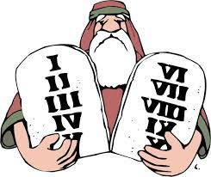
ten Commandments of Computer Ethics
8. Thou shalt not appropriate other people’s intellectual output.
9. Thou shalt think about the social consequences of the program you are writing or the system you are designing.
10. Thou shalt always use a computer in ways that ensure consideration and respect for your fellow humans.

Slide 27
acknowledgement
Introduction to Engineering Ethics by Mike W. Martin and Roland Schinzinger : McGraw Hill Higher Education : ISBN 978-0-07-248311-6 MHID 0-07-248311-3
https://en.wikipedia.org/wiki/Social_media
https://www.techmaish.com/advantages-and-disadvantages-of-social-media-for-society/
https://www.computerhope.com/jargon/e/ethics.htm
https://webcomicms.net/clipart-9298797-computer-ethics-cliparts
http://clipart-library.com/clipart/2003935.htm
https://thenextweb.com/security/2020/03/11/hackers-are-using-coronavirus-maps-to-infect-your-computer/
https://www.csoonline.com/article/2130877/the-biggest-data-breaches-of-the-21st-century.html
The Sunday times, March 15, 2020 – wijaya newspapers ltd, Colombo 2
https://www.pgalegal.net/blog/2017/10/what-is-computer-embezzlement.shtml
https://www.investopedia.com/terms/e/embezzlement.asp
https://egrove.olemiss.edu/cgi/viewcontent.cgi?article=1184&context=dl_hs

Slide 28
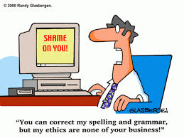

Slide 29

Thank you !!!!

